Slide 1
Welcome FeatureCAM 2007 Training
Customize Manufacturing

Slide 2
FeatureCAM
Delcam USA

Slide 3
Agenda
Session 1
1. Instructor Introduction
2. Web Interface
3. Class Introduction
4. Machining Attributes
Session 2
1. Virtual Tool Cribs
2. Feeds & Speeds
3. Configure the Post Processor

Slide 4
Attribute Introduction

Slide 5
Attributes
Attributes control manufacturing details
Learning how attributes work is key to controlling FeatureCAM
Attributes are kept in 3 levels
Machining
Feature
Operation
Notes:
The manufacture of each part can be customized by changing the values of a feature's manufacturing attributes. Attributes are set in check boxes and drop down lists on the various tabs of the Feature Properties dialog box.
The Properties dialog box for a feature has three tabs. *** do not go into too much detail here***
Dimensions tab contains critical dimensions for defining the feature’s shape.
Misc tab contains various parameters for the feature.
Strategy tab controls the types of operations that are created from the feature.
Operations have their own place in the treeview of the feature. Select an operation to see the tools tab, F/S tab, drilling tab, milling tab or Stepover tab for that operation.
Not every feature has every attribute but the attributes are arranged by tab, and then in alphabetical order.

Slide 6
Machining Attributes
This is the “top level” of attributes
Set no attribute on your feature, and you get the top level
Set an attribute on your feature, and that setting takes precedence
Setting an attribute at the top level can cause changes in all features
Notes:
Machining attributes
The default behavior for manufacturing is controlled by default machining attributes. These attributes can be modified so that the system’s default behavior can better represent the practice of your shop. To override these settings for a particular feature, use feature attributes. These attributes are set directly on the feature.
Select Machining Attributes in the Manufacturing menu to open the Machining Attributes dialog box. The machining attributes are broken into three different categories, milling, turning and wire.

Slide 7
Feature & Operation Attributes
Feature Attributes
  Control settings on the feature
  Control parameters that apply to all operations in the feature
  The middle level of attr control
  There aren’t very many of these
Operation Attributes
  Control parameters about an operation
  The lowest level of attr control
  There are lots of these

Slide 8
Strategy Attributes

Slide 9
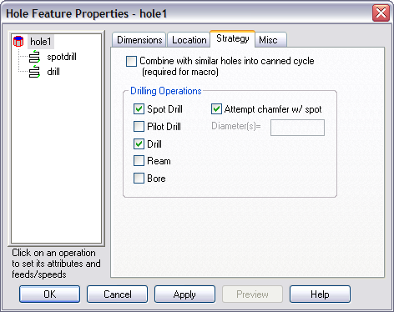
Drilling Strategy Attributes
Drilling operations control how the hole is cut
Checking the boxes adds operations to the tree view
Adding Ream or Bore reduces the size of the drilling tool
If Attempt chamfer with spot is checked, chamfer operation is performed with the spotdrill
Pilot drill requires the specification of the drill diameters
Notes:
Note that under the machine attributes, Prefer SpotDrill and Prefer Centerdrill control which kind of operation is created when the spotdrill checkbox is checked.
(Open up a part and create a simple hole with a small chamfer.
Go to the Strategy tab and toggle the Attempt Chamfer w/ Spot attribute.
Point out how the Chamfer operation in the tree view toggles.
Click on the drill operation and go to the tools page.
Point out the diameter of the drill.
Return to the Strategy page and click the Ream checkbox.
Revisit the tooling selected for the drill operation and show them how the drill diameter has been reduced.)

Slide 10
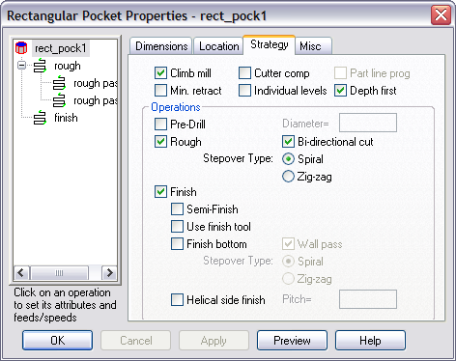
Milling Strategy Attributes
Rough, Finish and Semi-finish determine basic process plan
Selects cutter comp
Stepover type (zigzag-spiral)
Notes:
Climb mill
Climb mill determines whether the tool is on the left side of the machined edge (in the direction of tool travel). If it is off, conventional milling occurs and the tool is on the right side of the machined edge.
Part line program
Part line program is a particular kind of cutter compensation for milled features. If enabled, the actual drawing dimensions of the feature are output as the toolpath rather than the center line of the tool.
Depth first
Checking the Depth first option will cut each region of the feature completely before moving on to another region. The toolpaths descend in Z. If this option is unchecked then all regions of a feature are cut at one Z level before descending to a deeper Z-level. Note that this attribute has no effect if the toolpaths for your feature do not rapid between regions of the feature.
The figures below show how regions of a feature are completely cut before moving on to another region.
Individual levels
Many roughing cuts are performed at multiple Z levels due to the depth of the feature. If you check Individual levels on the Strategy page, you will be able to customize the manufacturing attributes of each level.
Minimize tool retract
Minimize tool retract is a milling attribute that reduces that amount of retracting that the tool will perform while milling a feature. Instead of retracting, the tool will continue feeding to its next location.
Finish bottom
Finish bottom finishes the bottom of a feature with a flat endmill up to the beginning of any bottom radius if present.
Wall pass
Wall pass only applies to the finishing passes of milling features where the bottom is finished. If wall pass is on, then the bottom will be finished up to the finish allowance on the wall. The walls are then finished in a separate pass.
Finish walls
If this attribute is checked, then the finish allowance is left on the walls of the groove. Checking this attribute also enables the Wall pass option.
Helical side finish
Selecting helical side finishing creates a continuous spiral finishing pass on 2.5D milling features. The tightness of the spiral is controlled by the Pitch parameter. A smaller pitch results in a tighter spiral.

Slide 11
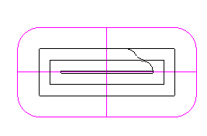
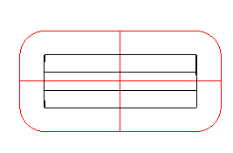
Roughing Strategies
Two basic cutting strategies
Spiral
  Starts in the center and works outward
Zig-zag
  Starts in a corner and moves back and forth
Spiral
Zig-zag
Notes:
(Create a rectangular pocket and play with the two roughing strategies.)
(If anyone asks how you control the start point and direction of zig-zag, it is a combination of the Climb mill strategy attribute and the Zig-zag angle milling attribute. Look up the Zig-zag angle attribute in the on-line help for more information.)

Slide 12
Mill Roughing Attributes

Slide 13
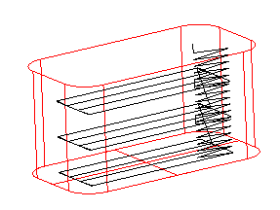


Individual Levels
Strategy Tab Attribute
Milled features can be cut at multiple Z depths
If Individual Levels is checked, each Z level pass is listed in the tree view and can be controlled separately
Otherwise all levels are controlled by a single operation
Indiv. Levels
turned off
Indiv. Levels
turned on
Notes:
Create a rectangular pocket with length 2 inches, width 1 inch and depth 1 inch.
This should be cut at 3 Z depths.
Toggle Individual Levels and see how the tree view changes.

Slide 14
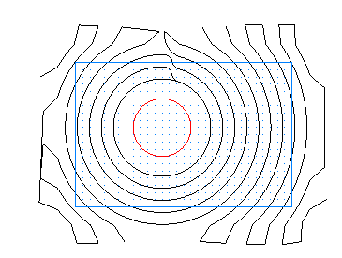
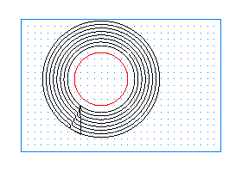
Total Stock
Milling Attribute
Controls the extent of the roughing paths
Without Total Stock, the paths cut the corners off the stock and work their way in
With Total Stock set, the boss shape is offset to get the shape of the paths
The Total Stock is the distance the paths are offset
Total
Stock
Distance
Standard Roughing
Total Stock Roughing
Notes:
(Make a simple circular boss and experiment with the total stock attribute on the roughing pass.
Make sure that the multiple roughing tools attribute is blank.)

Slide 15
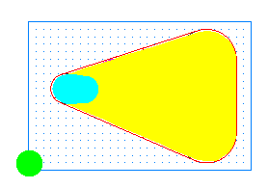
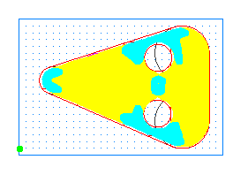
Multiple Rough Diameters
Milling Attribute
List a series of diameters, separated by commas
List “0” as the final diameter to get FeatureCAM to select the final tool
Notes:
Make a simple rectangular pocket out of three circles. Set the radius of two be 0.5 inch and make the other radius 0.25.
Set the Multiple Rough Diameter attribute to 0.375,0 and simulate in 2D.
***Eric will make a file like this one and link it to this page***

Slide 16
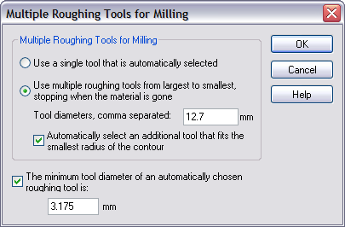
Multiple Roughing Defaults
Multiple Roughing Machining Attributes
  Under Tool Selection Tab
Click Use Single Tool … if you want single tool roughing by default
Click Use Multiple Roughing … if you want multiple tool roughing to be the default
Notes:
FeatureCAM has Use Multiple Roughing as the default (0.5,0).
For you guys supporting the software, this will answer the questions ‘why do I get a .5 tool in FC?’ BECAUSE OF MULTIPLE ROUGHING TOOLS

Slide 17
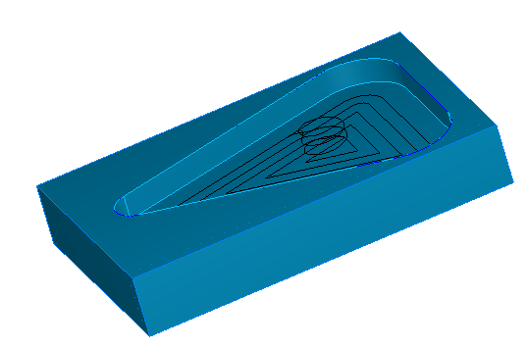
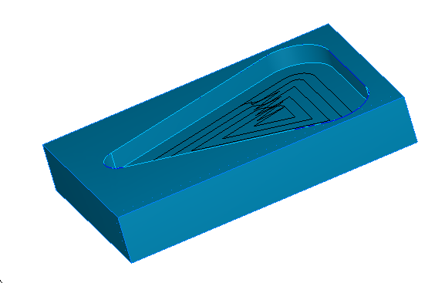
Ramping Into the Part
If Helical Ramping (milling attribute) is turned on, the tool ramps in with a circular spiral
If Helical Ramping is turned off, the tool zig-zags down into the material
Notes:
ANOTHER IMPORTANT TIP:
To Plunge directly down into the part set the max ramp angle to 0

Slide 18
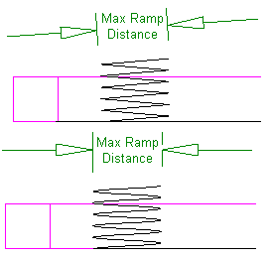
Controlling Ramping
Max Ramp Distance (milling attribute) controls the diameter of the helix or the length of the linear ramp zig-zags
Max ramp angle is the maximum slope of the tool’s entry. FeatureCAM will not exceed this value
  Set to 0 for straight plunge

Slide 19
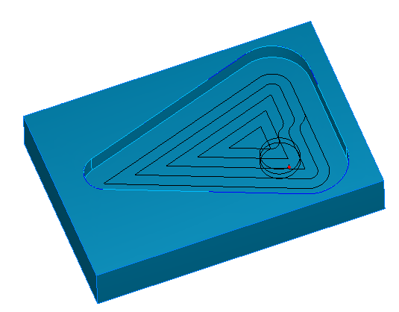
Plunge Points
Plunge points are used to explicitly control pre-drill points or where the tool will enter the part
Can enter a single point or a linear curve
Ignored if plunging there would cause a gouge
Used for rough and finish
Plunge Point
Notes:
Using plunge points to control the start point of a finish milling pass
A plunge point is one in which the tool makes a downward movement in Z. The user has control over these by using the "plunge point" attributes in his roughing and finishing passes.
Talk about Plunge ,start and retract are all related

Slide 20
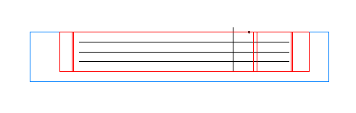
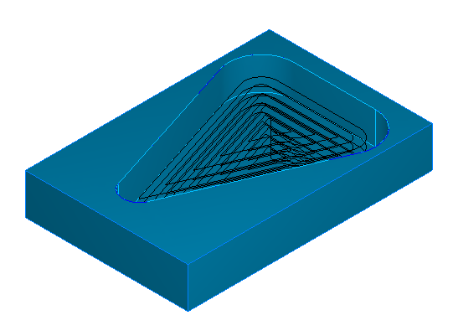
Z Increment
Rough pass Z increment (milling attribute) sets the Z step between roughing passes
Notes:
Z increment
Z Increment is the depth of each cut of the facing operation.

Slide 21
Mill Finishing Attributes

Slide 22
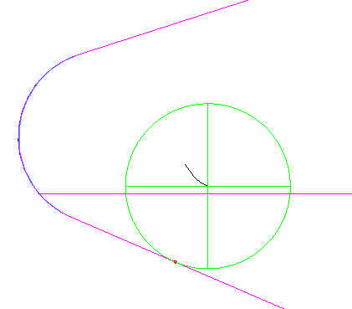
Start Points
Sets where you would like the tool to contact a 2.5D milling feature on the finishing pass.
Tool will ramp in and contact the wall at this point
Start Point
Notes:
Use Start point to explicitly set where you would like the tool to contact a 2.5D milling feature on the finishing pass.
If this attribute is not set the start point is automatically calculated.

Slide 23
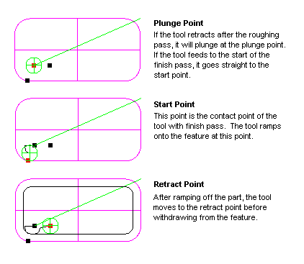
Points Controlling a
Finish Pass
Notes:
Retract Point:This is the point that the tool will retract to after the operation.

Slide 24
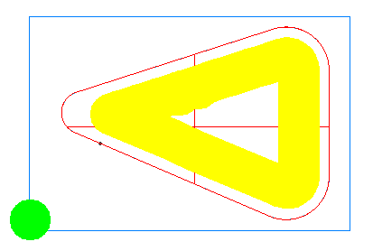
Side Leave Allowance
Amount to leave on the side of a milled feature after the finish pass

Slide 25
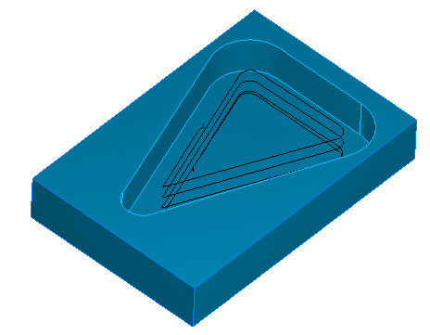
Helical Side Finish
Strategy attribute
If checked, finish will be performed with a continuous helical move
If not, a single pass will be performed
  Unless the Finish Pass Z Increment is set
Notes:
Note tip: Helical side finish is good for not leaving witness marks.
Helical side finish
Selecting helical side finishing creates a continuous spiral finishing pass on 2.5D milling features.
The tightness of the spiral is controlled by the Pitch parameter. A smaller pitch results in a tighter spiral.
If Helical side finish is turned on the features is finished in a single pass or cut in numerous passes with constant Z heights as shown below.
See Finish pass z increment or Individual levels for more information about other finishing options. See Helical ramping for information about approaching a feature using a helical move.

Slide 26
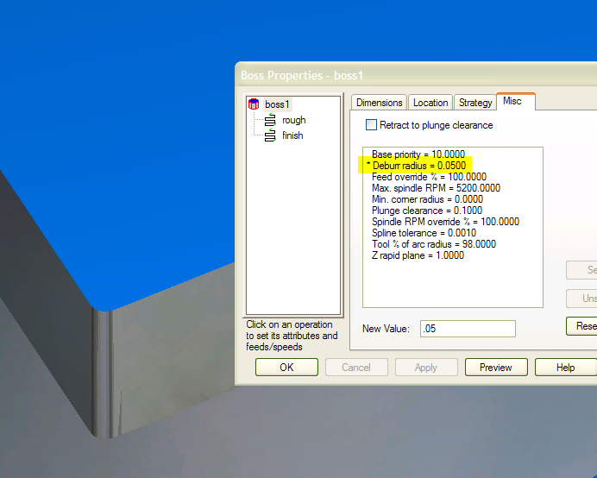
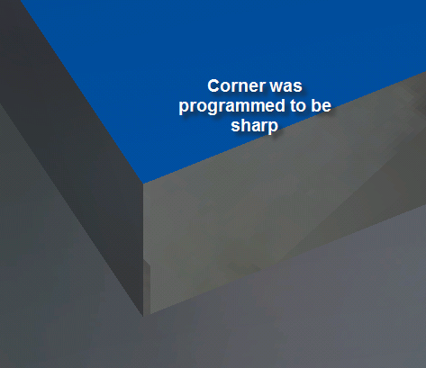
Deburr Radius
Deburr Radius and Minimum Corner Radius add a small radius to corners that are sharp

Slide 27
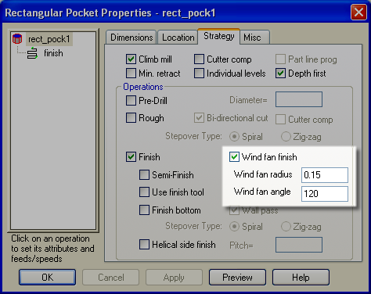
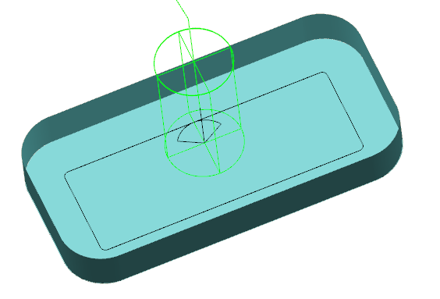
Windfan
Notes:
Added to customize manufacturing, found in help

Slide 28
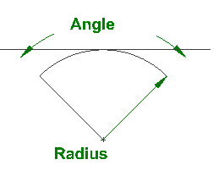
Windfan
Enter and exit at same position
This type approach taught to beginning machinists
Controlled by angle and radius

Slide 29
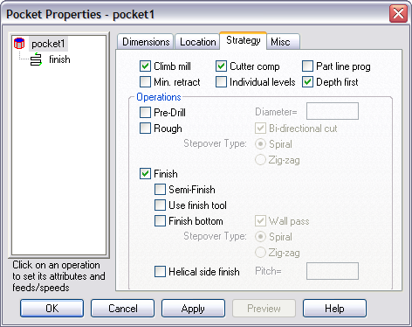
Cutter Compensation
Strategy Attribute
If set, Machine control will offset the lines and arcs of a toolpath to account for a tool’s actual diameter.
Typically used to compensate for tool wear
Direction depends on value of Climb Mill attribute
Notes:
Climb mill
Climb mill determines whether the tool is on the left side of the machined edge (in the direction of tool travel). If it is off, conventional milling occurs and the tool is on the right side of the machined edge.
Part line program
Part line program is a particular kind of cutter compensation for milled features. If enabled, the actual drawing dimensions of the feature are output as the toolpath rather than the center line of the tool.
Depth first
Checking the Depth first option will cut each region of the feature completely before moving on to another region. The toolpaths descend in Z. If this option is unchecked then all regions of a feature are cut at one Z level before descending to a deeper Z-level. Note that this attribute has no effect if the toolpaths for your feature do not rapid between regions of the feature.
The figures below show how regions of a feature are completely cut before moving on to another region.
Individual levels
Many roughing cuts are performed at multiple Z levels due to the depth of the feature. If you check Individual levels on the Strategy page, you will be able to customize the manufacturing attributes of each level.
Minimize tool retract
Minimize tool retract is a milling attribute that reduces that amount of retracting that the tool will perform while milling a feature. Instead of retracting, the tool will continue feeding to its next location.
Finish bottom
Finish bottom finishes the bottom of a feature with a flat endmill up to the beginning of any bottom radius if present.
Wall pass
Wall pass only applies to the finishing passes of milling features where the bottom is finished. If wall pass is on, then the bottom will be finished up to the finish allowance on the wall. The walls are then finished in a separate pass.
Finish walls
If this attribute is checked, then the finish allowance is left on the walls of the groove. Checking this attribute also enables the Wall pass option.
Helical side finish
Selecting helical side finishing creates a continuous spiral finishing pass on 2.5D milling features. The tightness of the spiral is controlled by the Pitch parameter. A smaller pitch results in a tighter spiral.

Slide 30
Part Line Programming
Sub mode of cutter compensation
Actual curve dimensions are output
Entire compensation for the tool done on the machine

Slide 31
Tooling

Slide 32
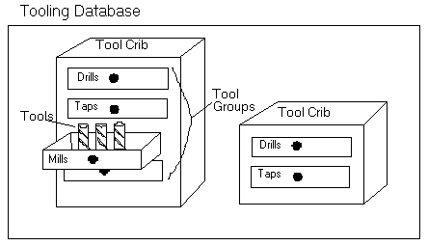
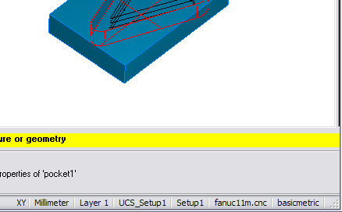
Tooling Introduction
The tooling database is consists of multiple tool cribs
Tool cribs are named collections of tools
All tools are selected for a part from the current tool crib
Double click on crib name in status bar to change cribs
Current Crib
Notes:
Tool crib
A tool crib is a named tooling database. You can create man of these to reflect all of the tools owned by your shop, or the tools specifically loaded specific machine tools.

Slide 33
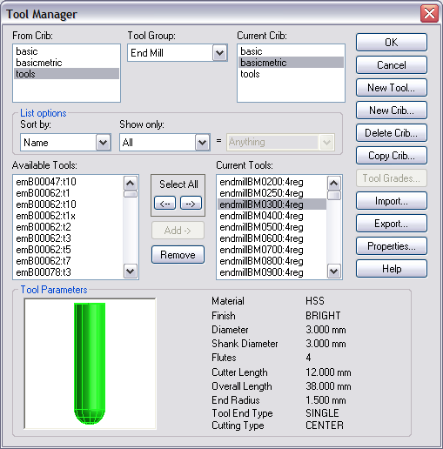
Tool Manager Introduction
FeatureCAM comes with Basic and Tools crib
  Tools has 4,000 tools
  Basic ~100 tools
Tool Manager gives you access to entire tooling database Easy to move tools from one crib to another
Notes:
Tool manager
Use the Tool Manager to view, modify or add tools to a toolcrib. Tools are separated into groups. The Tool Group drop-down list contains the groups supported by FeatureMILL.
The Tool Manager only shows one type of tool at a time. The dialog box is arranged so it’s convenient to move tools from one crib to another. In general you want to have the tools toolcrib listed as the From crib and the basic toolcrib listed as the To crib.
The fields of the Tool Manager dialog box are explained below.

Slide 34
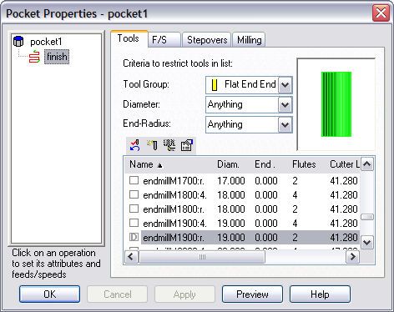
Tooling Tab
Tooling tab for an operation allows you to search for tools and change tools
Enter criteria
Check checkbox to select another tool
Double-clicking on row of table displays tool details
Search Criteria
Tool List

Slide 35
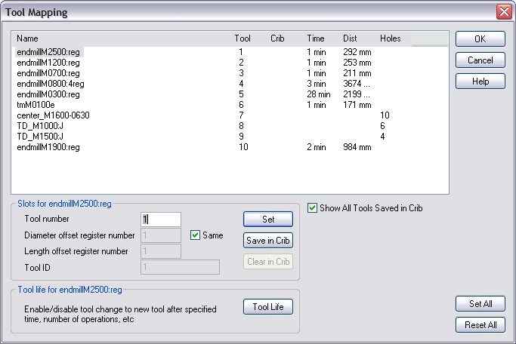
Tool Mapping
FeatureCAM automatically assigns tool numbers
You can rearrange them in the Tool Mapping dialog box
You can permanently assign a tool number to a tool in the database
Notes:
Tool Mapping
Tool Mapping is where you change the tool slot assigned to the selected tool. You can change the cutter comp. offset register for any tool here too. Access this dialog box by selecting Tool mapping from the Manufacturing menu.
The dialog box has a table at the top. Each row of the table represents a tool. Click on a name of a tool to modify its values in the following fields below the table.
Tool number
This field corresponds to the Tool column in the table and is the current tool slot number for that tool. Tools can occupy the same tool slot.
Diameter offset register number
This field corresponds to the Comp column in the table and is the diameter cutter comp. offset register for that tool. Note that the Same checkbox must be unchecked to assign this value to a tool.
Length offset register number
Length offset register number corresponds to the Offset column in the table and is tool length offset register. Most lathe controllers have a single register that contains the length and diameter offset values. In this case, the Length offset register number is the important field to set in FeatureCAM. Note that the Same checkbox must be unchecked to assign this value to a tool.
Tool ID
Tool ID (Tool in the table) is the tool ID register for the tool. This is a seldom used field that is used by Bridgeport lathes and occasionally for Cincinnati Machines lathes. Note that the Same checkbox must be unchecked to assign this value to a tool.

Slide 36
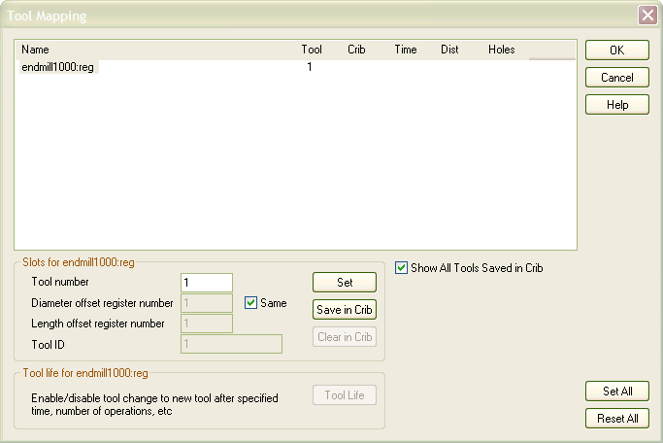
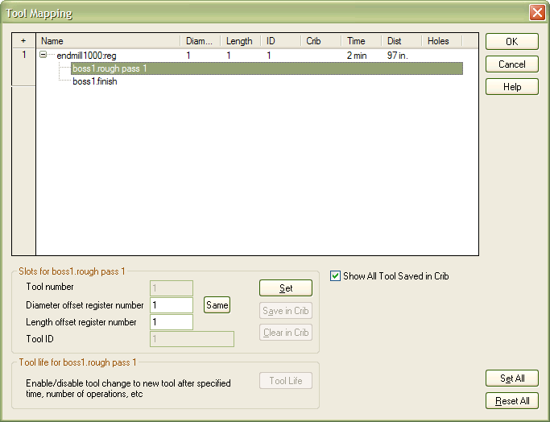
Tool Registers per Operation
V12
V13
Notes:
Added this so that a different offset could be used depending upon the operation.

Slide 37
Feeds and Speeds

Slide 38
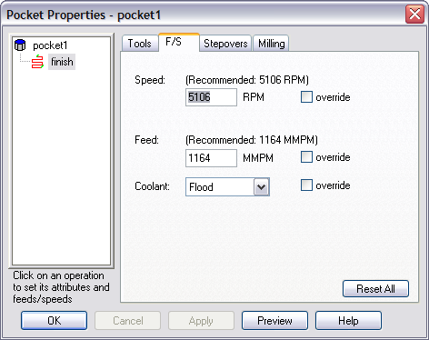
F/S Tab
Automatically calculated feeds and speeds are displayed on this tab
Type in new values to override
Notes:
Feeds and speeds
Feed (tools tab)
Feed displays the feed of the tool that performs the currently selected operation. Override the setting by typing the new value directly in the display field. The Override check box automatically selects itself.
The feed is calculated from the speed and feed table for the stock material. You can change the material’s table to affect speeds and feeds for that material in all cases by selecting Feeds and Speeds Tables in the Options menu. Or you can set global percentages to change feeds and speeds for all parts by selecting Default Attributes in the Options menu.
Feed and speed values are calculated automatically for each operation based on FeatureMILL’s build-in feed/speed databases. You can also explicitly set the feed or speed value for any operation.
TIP Max speed is controlled in the post under cnc-info -> feeds/speed

Slide 39
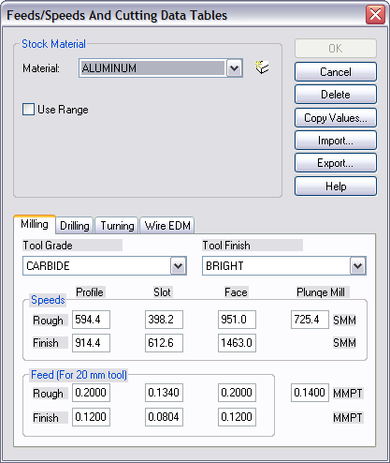
Material Database Introduction
Feeds and speeds are calculated from internal tables
Tables match stock material, tool material, tool finish and cut type to calculate a value
Tables can be modified Values are for an inch tool
Other diameters are interpolated
Notes:
Values are based on a 1.00 tool.
How feedrates are scaled
Feedrates are specified for a 1” (or 20mm) tool. For tools that are other diameters, the feedrates are scaled linearly. For example, the feedrate for a 0.25 tool is ¼ of the table rate.

Slide 40
Post Processing

Slide 41
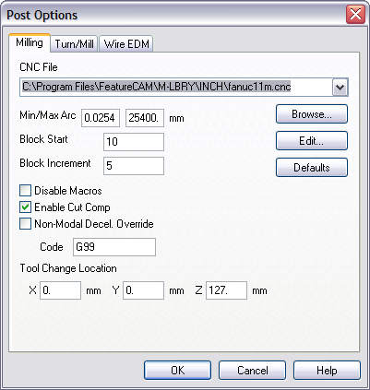
Post Processing Introduction
Option in Manufacturing menu
Change post with Browse button
Code is regenerated in NC window when the post is changed
Tool change location is critical for simulation
  Often a source of “gouging” in a 3D simulation
Notes:
TIP: TOOL CHANGE LOCATION (VERY COMMON QUESTION).
Also enable-disable macros

Slide 42
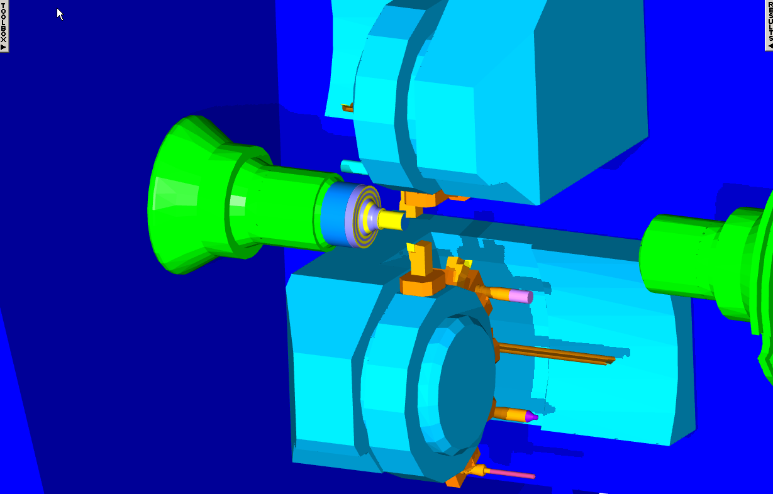
Simulation Options
Shadows, etc.

Slide 43
Production Milling & Turning
Concerned with efficiency of toolpaths for milling and turning for the manufacture of large runs
Two-pronged approach:
  Make FeatureCAM be smarter
  Give the user direct control for situations that we haven’t been able to address yet (i.e. toolpath editing)
Notes:
**mjb – Will reuse slide

Slide 44
Course Review
Attribute overview
Drilled attributes
Milling attributes
Tooling introduction
Feed/speed introduction
Changing post processors

Slide 45
Questions?

